Slide 1
Red Wine Quality Project
Domain : Chemical test

Slide 2
Introduction
Machine learning has made its foray into food and beverages as well and it is being applied to assess the quality of produce using different parameters. In this problem, the goal is to model the quality of red wine based on its physical properties. This dataset consists of attributes related to the red wine variant of the Portuguese wine.
Input Variables:
1 - fixed acidity
2 - volatile acidity
3 - citric acid
4 - residual sugar
5 - chlorides
6 - free sulfur dioxide
7 - total sulfur dioxide
8 - density
9 - pH
10 - sulphates
11 - alcohol content

Slide 3
Sample Dataset
fixed acidity | volatile acidity | citric acid | residual sugar | chlorides | free sulfur dioxide | total sulfur dioxide | density | pH | sulphates | alcohol | quality
0 | 7.4 | 0.70 | 0.00 | 1.9 | 0.076 | 11.0 | 34.0 | 0.9978 | 3.51 | 0.56 | 9.4 | 5
1 | 7.8 | 0.88 | 0.00 | 2.6 | 0.098 | 25.0 | 67.0 | 0.9968 | 3.20 | 0.68 | 9.8 | 5
2 | 7.8 | 0.76 | 0.04 | 2.3 | 0.092 | 15.0 | 54.0 | 0.9970 | 3.26 | 0.65 | 9.8 | 5
3 | 11.2 | 0.28 | 0.56 | 1.9 | 0.075 | 17.0 | 60.0 | 0.9980 | 3.16 | 0.58 | 9.8 | 6
4 | 7.4 | 0.70 | 0.00 | 1.9 | 0.076 | 11.0 | 34.0 | 0.9978 | 3.51 | 0.56 | 9.4 | 5

Slide 4
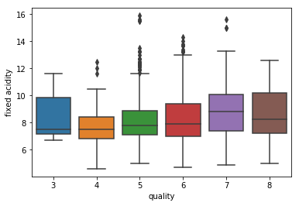
Exploratory Data Analysis
Lets Check the boxplot for all the input variables with Quality. Few posted here and remaining all in notebook.
All the boxplot shows there are lot of outliers.

Slide 5
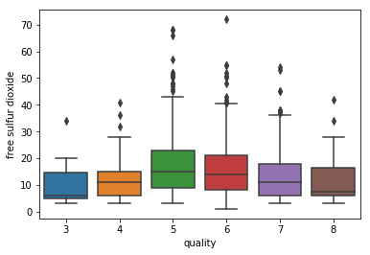
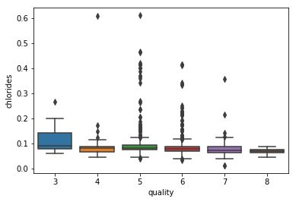
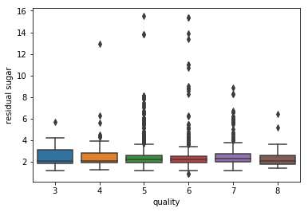
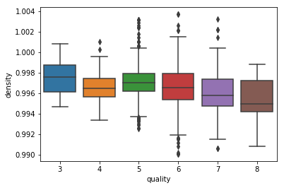

Slide 6
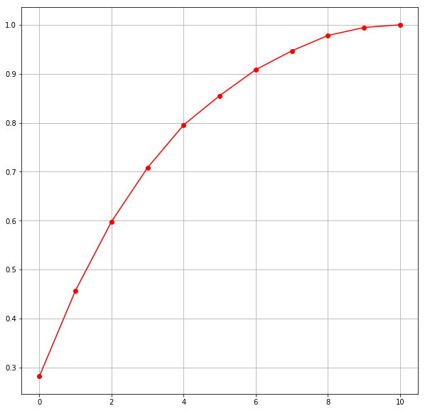
Principal Component Analysis
Import the packages
Scale the data using standard scaler
Perform PCA
Plot the graph to find Principal components
Components=8

Slide 7
Prediction and Modelling
Perform Logistic regression and Random forest for this dataset.
Fit the model, predict the model and test the confusion matrix and accuracy scores
Logistic Regression-[ 135 57] 72% accuracy
[ 55 152]
Random Forest -[156 36] 77.5% accuracy
[54 154]
SVM Classifier -[156 36] 77% accuracy
[54 154]
SVM Classifier test scores are same for both rbf and linear kernel

Slide 8
Conclusion
Same Accuracy (77%)for random forest and SVM.
These two models gives us good prediction accuracy for wine classification dataset.

